Slide 1
Mohd Saif Ansari [4PS15CS060] Darshan M C [4PS15CS030] Visvas TP [4PS16CS423] Jagdeesh Kumar [4PS15CS041]
A Three-Layer Privacy Preserving Cloud Storage
Under the guidance of:
Suraj B.S.
Asst. Professor

Slide 2
Presentation Flow
Project Objective
Terminologies Used
Existing System
Necessity of the Project
Proposed System
System Architecture
Flow Chart
Data Flow Diagram
Algorithms Used
Tools and Technologies
Future Enhancement

Slide 3
Project Objective
Data security
Data privacy.
Data integrity.
Data availability.
Improving security is a crucial goal no matter in academics or business.
TLS framework protects the data privacy, the implementation details of work ﬂow and the theoretical safety and efficiency analysis of the storage scheme.

Slide 4

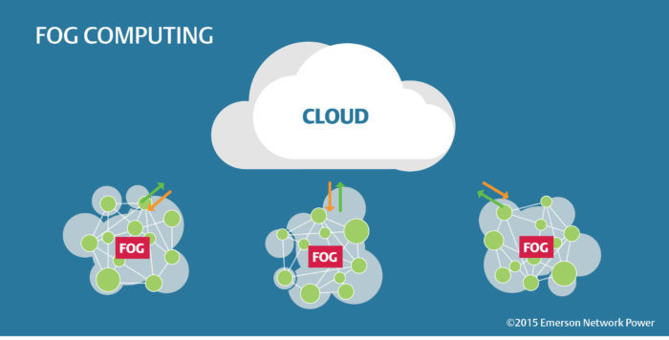
Terminologies Used
Cloud Computing
Fog Computing

Slide 5
Existing System
Cloud Server Provider (CSP) will take place of user to manage the data.
User do not actually control the physical storage of their data
Which results in the separation of ownership and Management.
The CSP can freely access and search the data stored in the cloud.
The attackers can also attack the CSP server to obtain the user’s data.

Slide 6
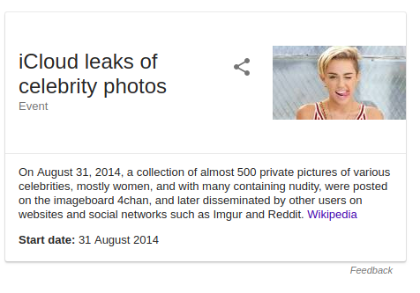




Slide 7
Proposed System
we propose a TLS scheme based on fog computing model
In our scheme, we split user’s data into three parts and separately save them in the cloud server, the fog server and the user’s local machine
Secure and effective access control
Privacy Preserving

Slide 8
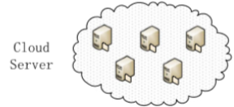
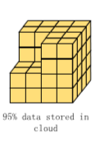
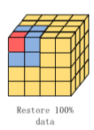
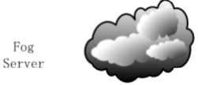






System Architecture

Slide 9
FLOW CHART
Login
Register
No
NO
Authenticate Data Owner
Data User
YES
YES
Select data
Apply Hashing Technique to reconstruct the data
Encrypt
Decrypt Data
Apply Hashing Technique to divide the data
Store in three layer
STOP

Slide 10
USE CASE DIAGRAM
Register
Login
Choose File
Encrypt
Divide the file using Hashing Technique
Upload into three layers
File Access Request
Accept Request
Data Owner
Data User
Reconstruct the file decrypt and Download

Slide 11
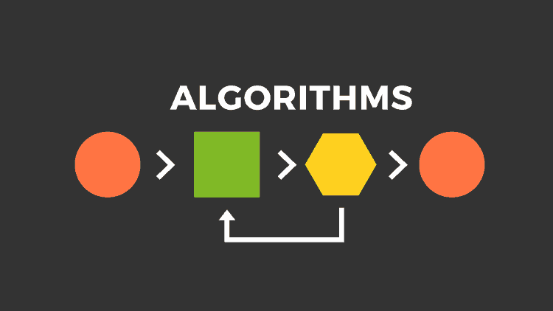
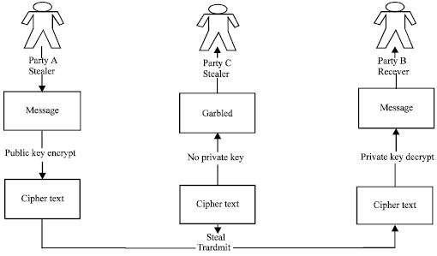
RSA Algorithm

Slide 12
Usage Of Algorithms…
start
Select data
Encoding(AES)
Hash Transform and dividing data into blocks
1% data
95% data
4% data
Local Storage
Cloud Server
Fog Server

Slide 13
AES Algorithm
FEATURES:
This is Symmetric key symmetric block cipher
Perform on 128-bit data, with 128/192/256-bit keys
Stronger and faster than DES and RSA
Why AES?
This is used for Encrypting and Decrypting Large amount of data uploaded by data owner.
The US government considers AES strong enough to protect secret information and even top secret info at the higher key lengths.
AES has built-in flexibility of key length, which allows a degree of ‘future-proofing’ against progress in the ability to perform exhaustive key searches.
It can able to Encrypt large amount of data when compared to RSA.

Slide 14
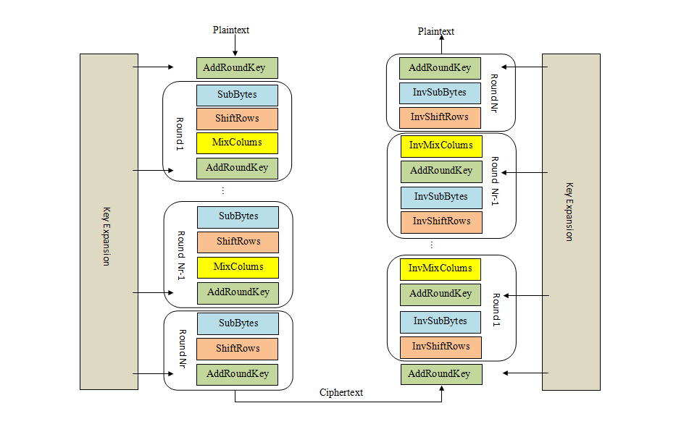
AES Structure

Slide 15
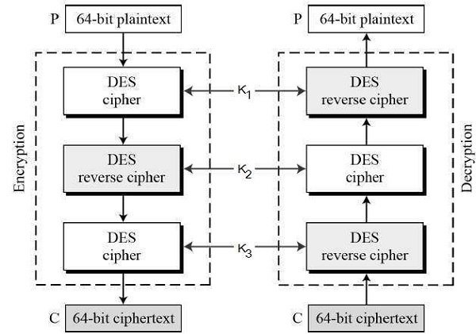
Triple DES Algorithm
This is used for authenticating the users by generating group signature key and other access keys.
Triple DES systems are significantly more secure than single DES.

Slide 16
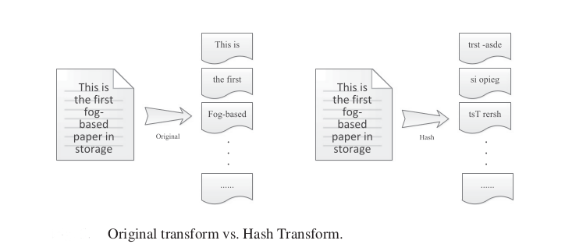
Hash-Solomon Algorithm
The hash code divides the sentence into different fragments according to random sequence.
Hash-Solomon code improves the privacy protection and prevents the attacker from getting fragmentary information.

Slide 17
Conti…
errors/noise
Data source Or Storage Devic Communication channel Data output
Or Storage Device
Reed Solomon Encoder
Reed Solomon Decoder
Reed-Solomon codes are block-based error correcting codes.
Reed-Solomon codes are used to correct errors in many systems.
1)It is possible to adjust block length and symbol size.
2)It provides wide range of code rate and efficient decoding techniques are available.
3)Highest efficient use of redundancy.

Slide 18
Tools and Technologies
Hardware Requirements
2 GB RAM
1.2 GigaHz Processor
512 MB Hard disk
Software Requirements
NetBeans 8.01vs
MySQL 3.2vs
Windows XP/7

Slide 19
Conti…
Java/J2ee
JDBC
JSP and Servlets

Slide 20

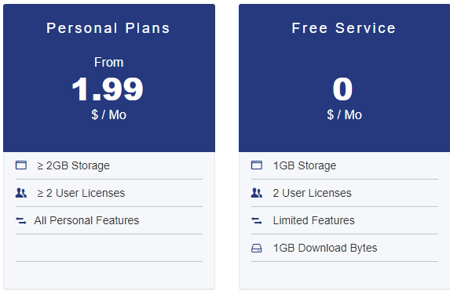
Cloud Used

Slide 21
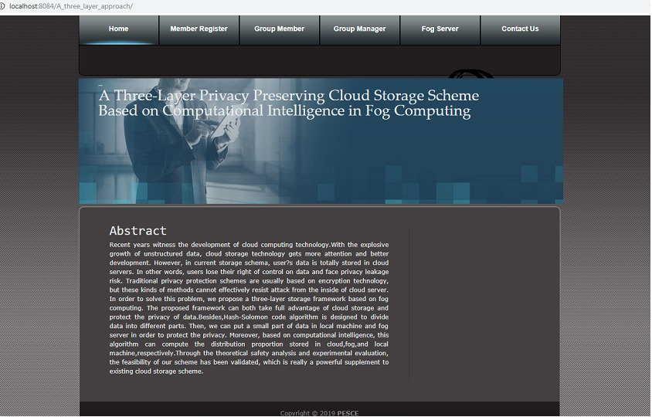
Demo
http://192.168.43.204:8084/A_three_layer_approach/

Slide 22
Thank-you

